Slide 1
`
WELCOME | Thank You For Joining

Slide 2
SERIES OVERVIEW
Session 1 | Good News
Session 2 | Identity
Session 3 | Sin
Session 4 | The Cross
Session 5 | Resurrection
Session 6 | Grace
- The Sower
- James and John
- Herod
Session 7 | Come and Die

Slide 3
SERIES OVERVIEW
Session 1 | Good News
Session 2 | Identity
Session 3 | Sin
Session 4 | The Cross
Session 5 | Resurrection
Session 6 | Grace
- The Sower
- James and John
- Herod
Session 7 | Come and Die

Slide 4
EXPLORE
LISTEN
DISCUSS
FOLLOW UP
20 Minutes Bible Study Discussion
20 Minutes Bible Talk/Video
20 Minutes Talk Through the Session
Read Some of Mark For Yourself

Slide 5
YouVersion Bible App
WAYS YOU CAN READ ALONG WITH US
BibleGateway
www.biblegateway.com
www.youversion.com or available at
App Store

Slide 6
SESSION 1 | GOOD NEWS

Slide 7
SESSION 1 | GOOD NEWS
EXPLORE
What’s your name and what made you come on Christianity Explored?
What’s the best news you’ve ever heard?

Slide 8
SESSION 1 | GOOD NEWS
LISTEN
Mark 1:1
“The beginning of the good news about Jesus the Messiah, the Son of God…”

Slide 9
*EMBED FILM*

Slide 10
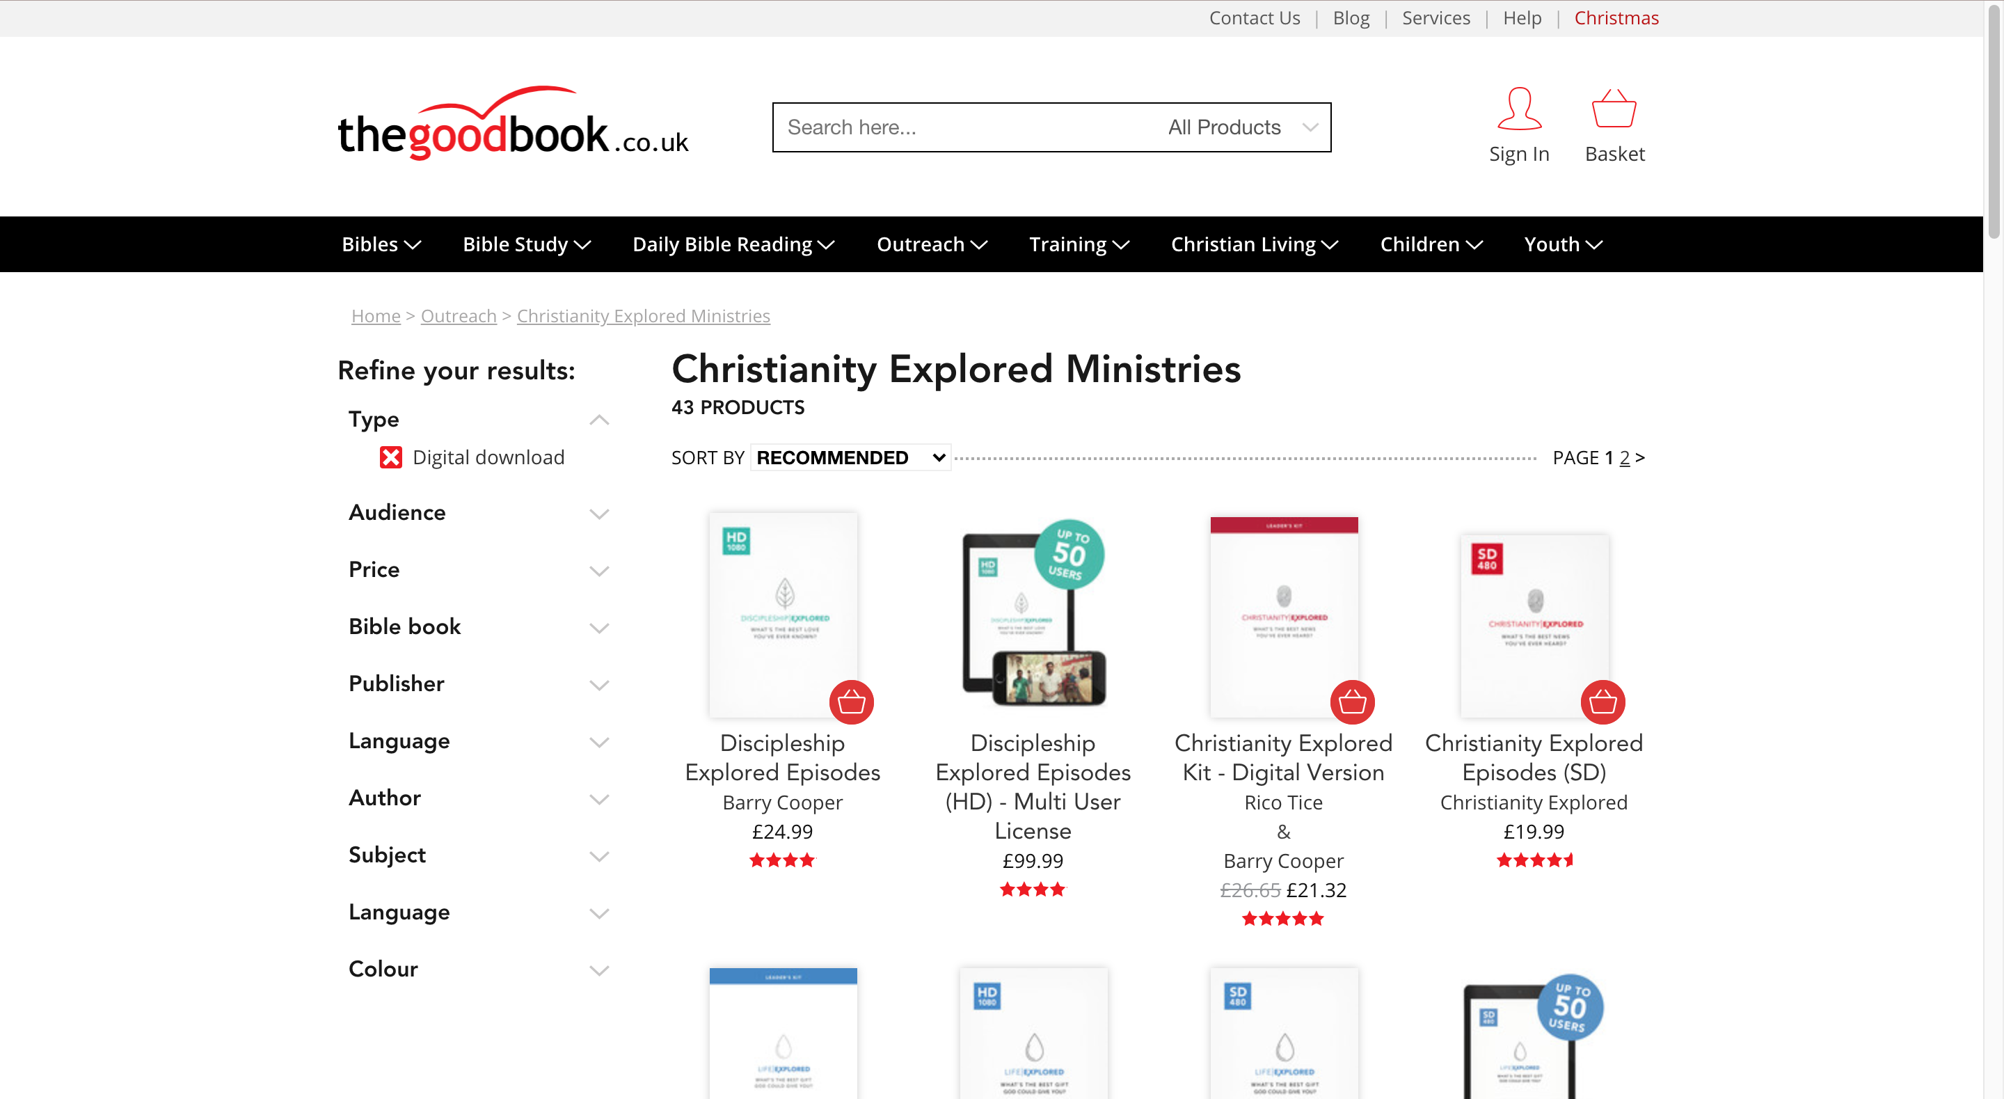
*delete slide before running course*
How To Access Video Content:
You can purchase the video content for the course at the Good Book Company:
https://www.thegoodbook.co.uk/outreach/cem/resource_type-digital-download/

Slide 11
SESSION 1 | GOOD NEWS
DISCUSS
1. Is there anything that intrigues or puzzles you about Jesus?
2. How do you feel about reading Mark’s Gospel?
3. If you could ask God one question, and you knew it would be answered, what would it be?
4. Think about the god you are asking that question to. What is that god like?

Slide 12
NEXT WEEK:
SESSION 2 | IDENTITY
How Does Mark Justify His Claims?

Slide 13
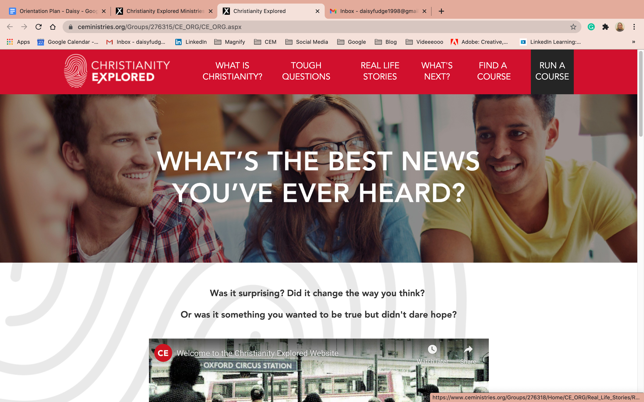
Find out more at | christianityexplored.org

Slide 14
*delete slide before running course*
How To Purchase Further Material:
You can purchase all of our content such as the leader guides, the video content and more from the Good Book Company:
https://www.thegoodbook.co.uk/outreach/cem/resource_type-digital-download/

