Slide 1
`
WELCOME | Thank You For Joining

Slide 2
SERIES OVERVIEW
Session 1 | Confident in Christ
Session 2 | Living in Christ
Session 3 | One in Christ
Session 4 | Obedient in Christ
Session 5 | Righteous in Christ
Session 6 | Transformed in Christ
Session 7 | Rejoicing in Christ
Session 8 | Content in Christ

Slide 3
SERIES OVERVIEW
Session 1 | Confident in Christ
Session 2 | Living in Christ
Session 3 | One in Christ
Session 4 | Obedient in Christ
Session 5 | Righteous in Christ
Session 6 | Transformed in Christ
Session 7 | Rejoicing in Christ
Session 8 | Content in Christ

Slide 4
WATCH
READ
DISCUSS
FOLLOW UP
Watch a 15 Minute Film
Read A Bible Passage
Talk Through the Session
Read Some the Bible For Yourself

Slide 5
YouVersion Bible App
WAYS YOU CAN READ ALONG WITH US
BibleGateway
www.biblegateway.com
www.youversion.com or available at
App Store

Slide 6
SESSION 1 | CONFIDENT IN CHRIST

Slide 7
*EMBED FILM*

Slide 8
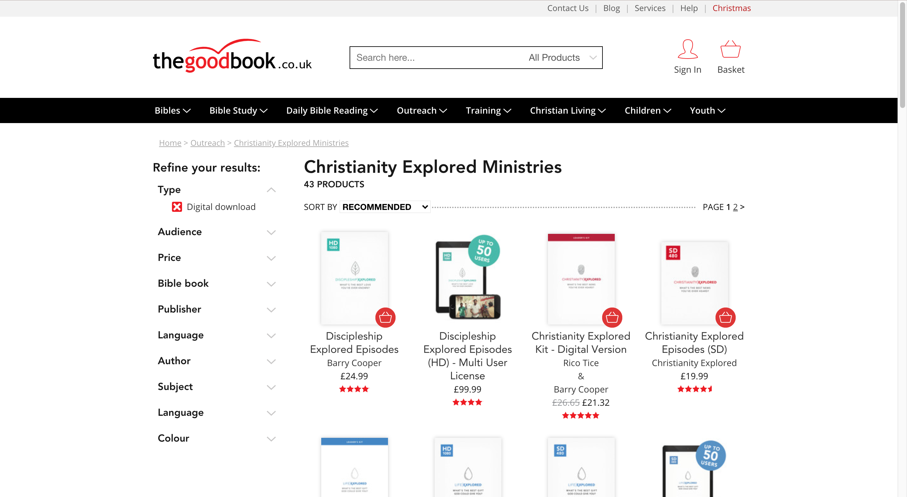
*delete slide before running course*
How To Access Video Content:
You can purchase the video content for the course at the Good Book Company:
https://www.thegoodbook.co.uk/outreach/cem/resource_type-digital-download/

Slide 9
SESSION 1 | CONFIDENT IN CHRIST
READ
Philippians 1:1-11
“Paul and Timothy, servants of Christ Jesus,
To all God’s holy people in Christ Jesus at Philippi…”

Slide 10
SESSION 1 | CONFIDENT IN CHRIST
DISCUSS
1. According to Philippians 1:6, what is Paul confident about?
2. How can he be so confident? (See verse 5.)
3. What do you think that phrase means, in practical terms? (See Philippians 2:25 and 4:14-16.)
4. So how can we be confident that God is working in us? What might that look like in your life and in your day-to-day relationships?

Slide 11
SESSION 1 | CONFIDENT IN CHRIST
DISCUSS
5. Someone might say, “If God will finish this work he started, why do I need to do anything?” What would you say to them?
6. A Christian friend is going through a tough time. They don’t feel confident that God loves them and is in control of what is happening to them. Is there something from the film or our discussion that might encourage them?
7. What has been most striking for you during this session?

Slide 12
NEXT WEEK :
SESSION 2 | LIVING IN CHRIST

Slide 13
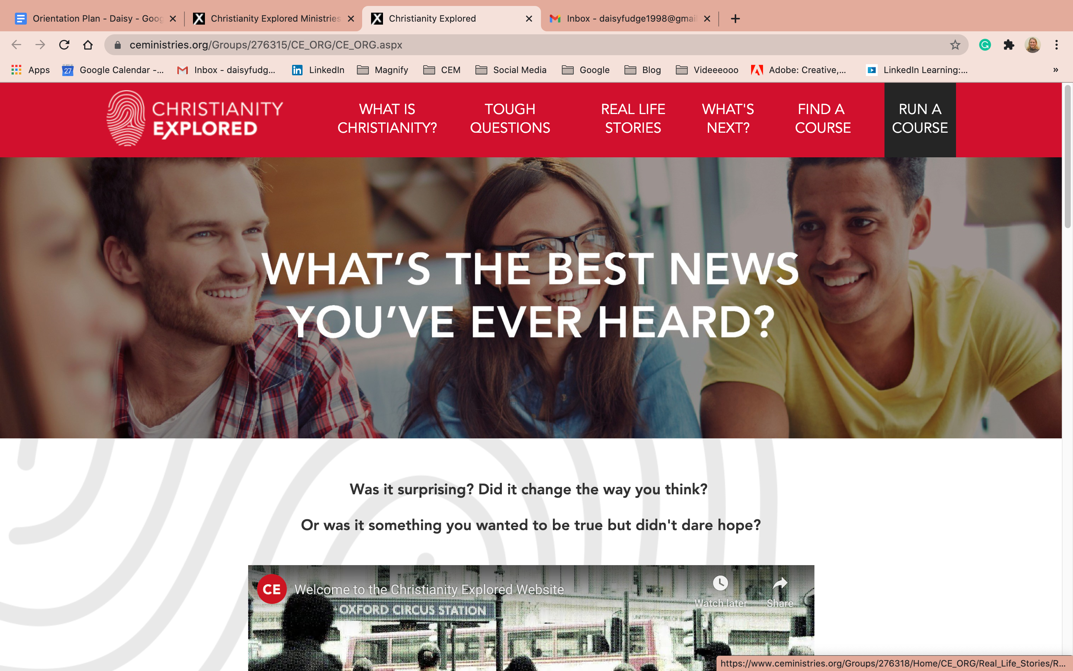
Find out more at | christianityexplored.org

Slide 14
*delete slide before running course*
How To Purchase Further Material:
You can purchase all of our content such as the leader guides, the video content and more from the Good Book Company:
https://www.thegoodbook.co.uk/outreach/cem/resource_type-digital-download/

